Slide 1
Personalized AI Writing Assistant
Group 8:
Lasya Reddy Edunuri
Manasa Vuppu
Brinda Vijayakumar
Github

Slide 2
List of Contents:
01
02
03
04
05
06
07
08
Problem
Statement
Motivation
Dataset
& Analysis
Implementation
vs Existing work
Methodology
Results
& Summary
Conclusion
& Future Scope
References

Slide 3
01 Problem Statement
“Creating personalized, high-quality content is difficult—AI-generated text often lacks the unique voice and nuance of individual writers.”
Key Challenges:
Loss of Personal Voice | AI models generate generic outputs, failing to reflect an individual's tone or vocabulary.
Limited Style Adaptability | Existing models are not fine-tuned for author-specific writing, reducing their usability.
Small & Unlabeled Datasets | Personal writing archives often lack metadata, making training and adaptation harder.
Evaluation Complexity | Lack of standardized metrics for stylistic accuracy; hard to evaluate “authenticity.”
Notes:
Manasa

Slide 4
02 Motivation
Why This Project Matters: “This project is both personal and purposeful—rooted in lived experience, and driven by the team’s desire to build meaningful AI.”
Personal
First hand experience
Deep understanding of Style
Unique Dataset
Technical
Full Pipeline Ownership
Advanced Techniques
Real-World Value
25
Notes:
Manasa

Slide 5
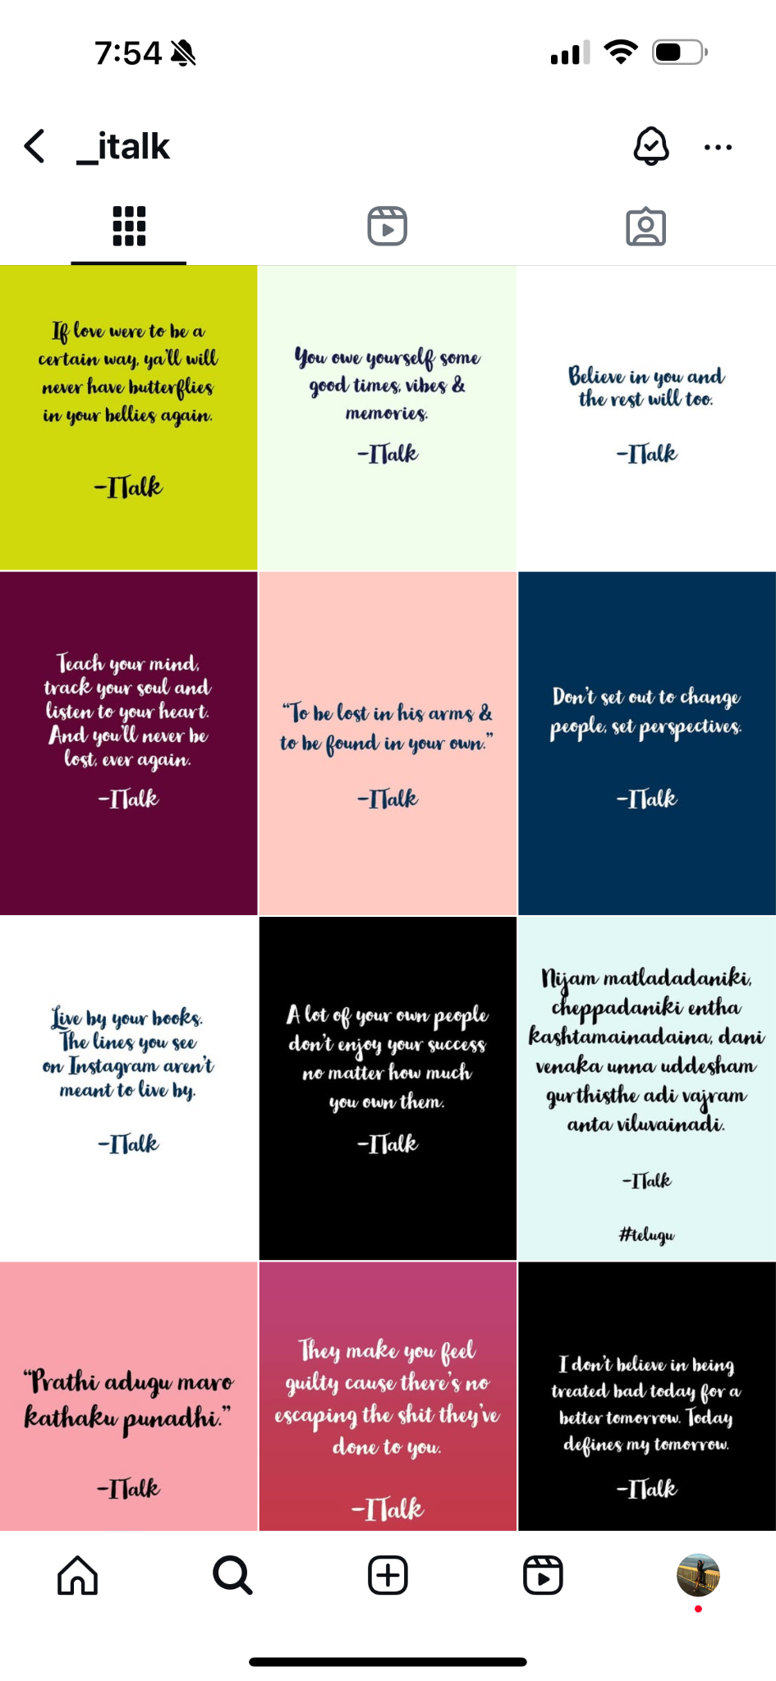

03 Dataset and Analysis:
SAMPLES
Dataset 1: Personal Writing Corpus
Source & Scope: Manually compiled dataset of quotes, SOPs, blogs, and reflections—spanning several years of original writing.
Curation Process: Text extracted from images using OCR Manual formatting for consistency and structure Categorized by tone, intent, and format (e.g., quote, SOP)
Purpose: Serves as the training base for AI modeling and evaluation of personalized writing generation.
Notes:
Lasya

Slide 6
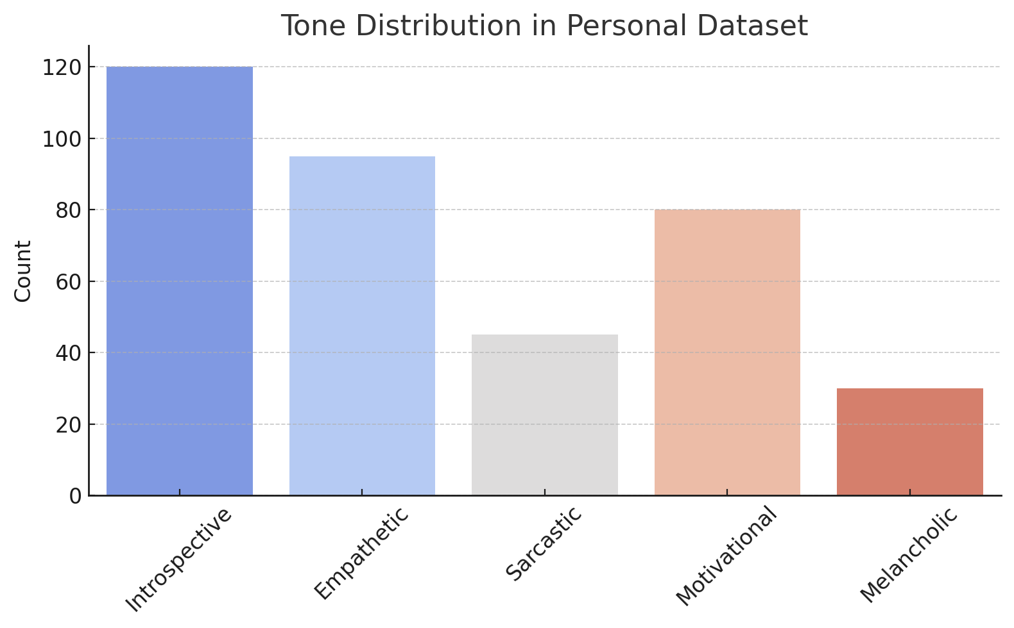
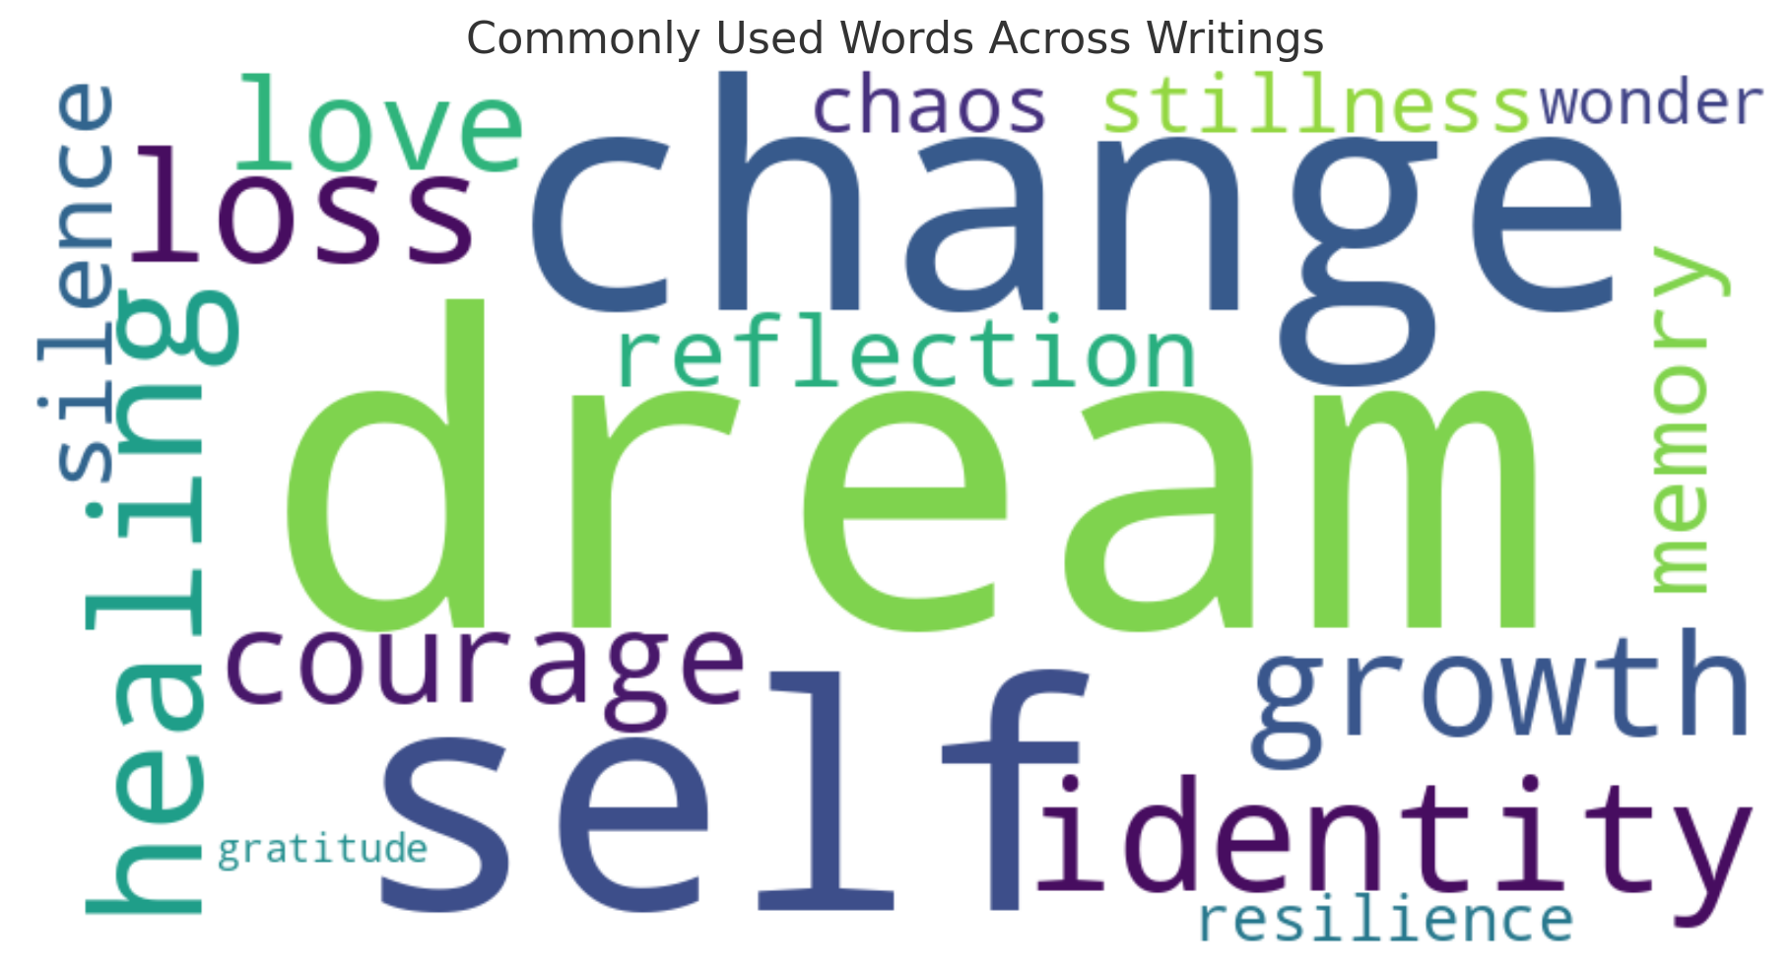
Visual Analysis Summary: Dataset 1
Reflects the emotional diversity and thoughtfulness in the writing style
Feature | Summary
POS Tagging: | Frequent use of adjectives and pronouns → suggests a personal and expressive tone
NER (Named Entity Recognition): | Mentions of people, abstract concepts, and time references → points to introspective themes
Lexical Diversity: | Moderate-to-high type-token ratio → reflects a rich but accessible vocabulary
Notes:
Lasya

Slide 7
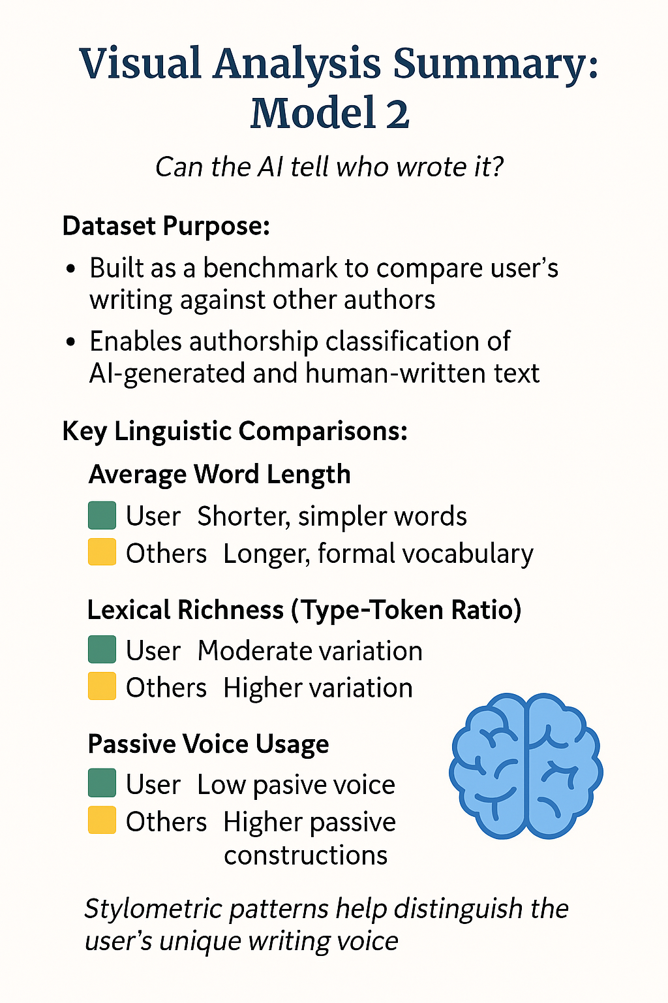
Dataset and Analysis:
Dataset 2: Multi-Author Benchmark + User’s
Content Variety: Includes Quotes, emails, blogs, and documents written by various authors from diverse domains.
Purpose: Enables stylometric comparisons between the user’s writing and others’—supports authorship classification and model validation.
Analysis Features:
Lexical richness
Syntactic structures
Punctuation and tone patterns
Passive vs. active constructions
Notes:
Lasya

Slide 8
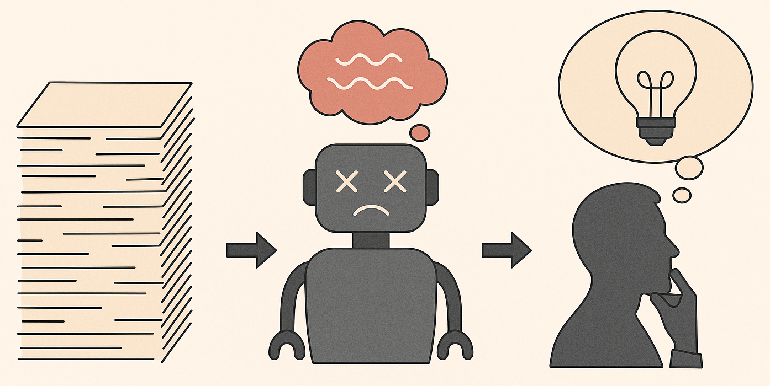
You think the models could go crazy on us?

Slide 9
Why we separated short and long form texts?/The Case for Treating Short and Long-Form Texts Differently
1
2
3
Early Hallucination Issues
More Efficient and Focused Fine-Tuning
Foundation for Future Expansion
Mixed datasets hallucinated facts and lost coherence. Tone inconsistencies and over-generalization.
Output lacked specificity and often repeated generic phrasing.
Homogeneous dataset helped the model converge faster.
More consistent evaluation using clarity, coherence, and relevance metrics.
Built a stable pipeline for training Inference and Evaluation.
Enables confident extension to other form formats
Notes:
Brinda

Slide 10
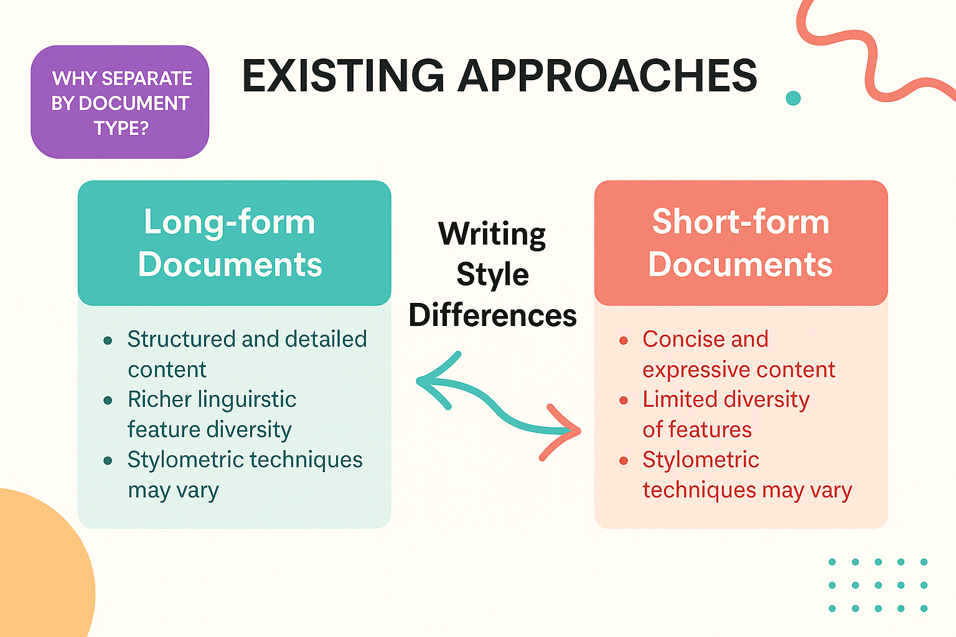
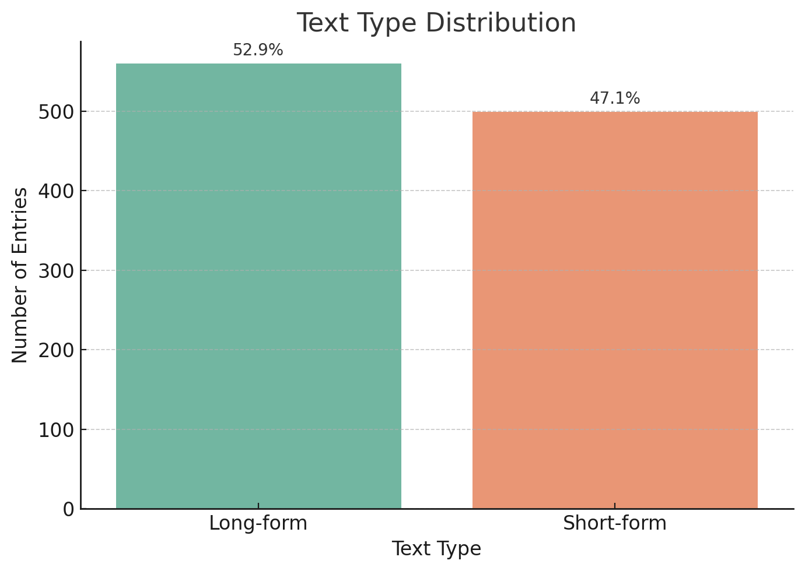
Pre-processing: Splitting of the dataset- 1
Preprocessing Steps:
Word and character count calculation
Stopword removal (stop_words='english')
Tokenization using CountVectorizer
n-gram extraction (bigrams, trigrams)
Cleaned text used to analyze top phrases and stylistic signatures
Separate analysis by document type
Long-form: SOP, Essays, Blogs
Short-form: Quotes, Letters
Notes:
Brinda

Slide 11
Model Selection Strategy: From Short to Long-Form Text
Author’s writing corpus (Collection of quotes, blogs, essays, sops)
Phase 1
Short form
(Quotes)
Short-Form Experiments
(GPT-2, T5, BART)
Phase 2
Long form
(SOPs)
Tiny Llama: Lightweight model for testing: Served as sandbox for pipeline design
Meta Llama: Chosen for its larger context window and better fluency
Mistral-7B: chosen for its large context window, instruction tuning, and strong stylistic fluency.
Notes:
Brinda

Slide 12
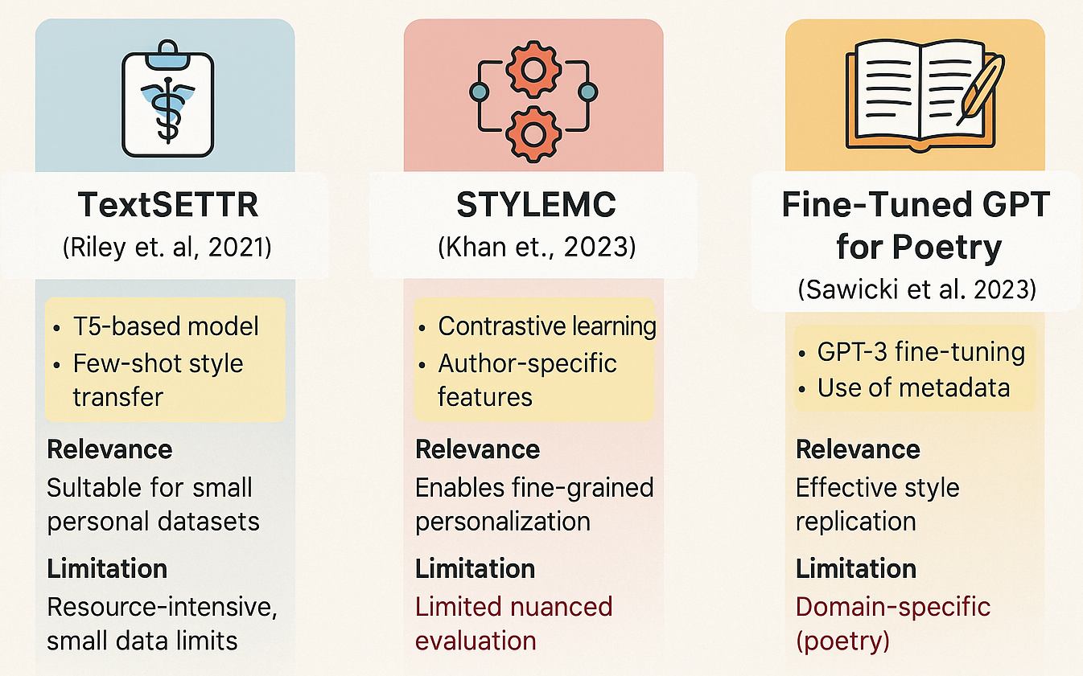
04 Our Implementation vs Existing Work:
TextSETTR (Riley et al., 2021)
T5 model + few-shot prompting: Style transfer using prompt-based conditioning (no fine-tuning needed)
Model v3 (T5 Few-Shot) injected 3 example quotes into the prompt:
[Example 1: “Even silence tells a story.”]
[Example 2: “You are allowed to begin again.”]
[Example 3: “Softness is not weakness.”]
→ Now rewrite: “You are not lost.”
STYLEMC (Khan et al.,
2023)
Style-specific scoring using contrastive features
Energy = weighted sum of fluency, semantics, style similarity
Model v2 (BART) generated multiple rewrite versions per input
Each version was scored using: Energy = 0.3 * Fluency + 0.3 * SemanticSim + 0.4 * StyleSim
Example:
v1: “You’re not lost.” → Score = 0.54 v2: “You are unfolding into new directions.” → Score = 0.78
Fine-Tuned GPT (Sawicki et al., 2023)
Fine-tuned GPT-3 with 300 poems
In Model v4 (T5 Metadata-aware), we simulated this by:
Annotating quotes with tone, text_type, and document_length
Conditioning prompts to say: “Generate a short, introspective quote in user’s voice.”
Notes:
Brinda

Slide 13

01
Dataset-1
Model-1
Short-form
05 Methodology:
Notes:
Manasa

Slide 14
Methodology: Model 1(Short-form texts)
Overview of Model 1 Variants
Model | Data Format/Metadata | Hyperparameters | Methodology | Reflection of Existing Methods
GPT | 125 - 355 M (v1) | Plain Quotes | Fixed Prompt | Static prompting without personalization | TextSETTR → Uses text-style vectors
BART | 140 M (v2) | Quotes with Style Vectors | STYLEMC-inspired energy scoring function: w₁ = 0.3 (fluency), w₂ = 0.3 (Semantic Similarity), w₃ = 0.4 (Style Similarity) | STYLEMC-inspired energy scoring function, Weighted scoring using cosine similarity | STYLEMC → Contrastive-inspired evaluation
T5 | 220 - 770 M (v3) | Quotes, Few-Shot Prompts | top_p = 0.95, temperature = 0.6, max_length = 50 | Few-shot declarative style prompting | TextSETTR → Uses metadata for style conditioning
T5 | 770 M (v4) | Quotes with Annotations (Tone, Type, Structure) | Adjusted for Metadata | Style-aware generation or post-eval cosine similarity ranking | TextSETTR → Uses text-style vectors
Metadata Used: Custom style vectors derived from user’s past writing and Annotated dimensions: tone, text type, structure, document length
Notes:
Manasa

Slide 15
Model 1: Sample Outputs (Short- Form Texts)
Version | Sample Output | What Changed | How It Improved
Ranking-4 v1 – GPT (Baseline) (125M – 355M) | “You are not lost, just finding a new path.” | Fixed prompt, no metadata | Basic fluency, but lacks personalization or emotional depth (Outputs are generic, lacking emotional depth or structure control)
Ranking-3 v2 – BART + STYLEMC (140M) | “Even when lost, you are rewriting the map of who you are meant to be.” | Scored with: w₁ = 0.3, w₂ = 0.3, w₃ = 0.4 | Adds style alignment and semantic closeness. Reflects more depth and tone control. (post-hoc control rather than generation tuning)
Ranking-2 v3 – T5 (Few-shot) (220M - Small 770M - Base) | “In every detour lies a destination written just for you.” | Few-shot prompting: 3 quote examples, top_p=0.95, temp=0.6 | Captures voice and flow from examples. More nuanced structure, emotional color (Slightly more prone to hallucinations without grounding)
Ranking-1 v4 – T5 + Metadata (770M) | “Your journey bends because it listens to the story your soul whispers.” | Conditioned on metadata: tone: introspective, type: quote | Output mirrors intent, tone, and format precisely. High fluency and personalization (Creating quote-style outputs where voice, tone, and structure must be tightly preserved)
Notes:
Manasa

Slide 16
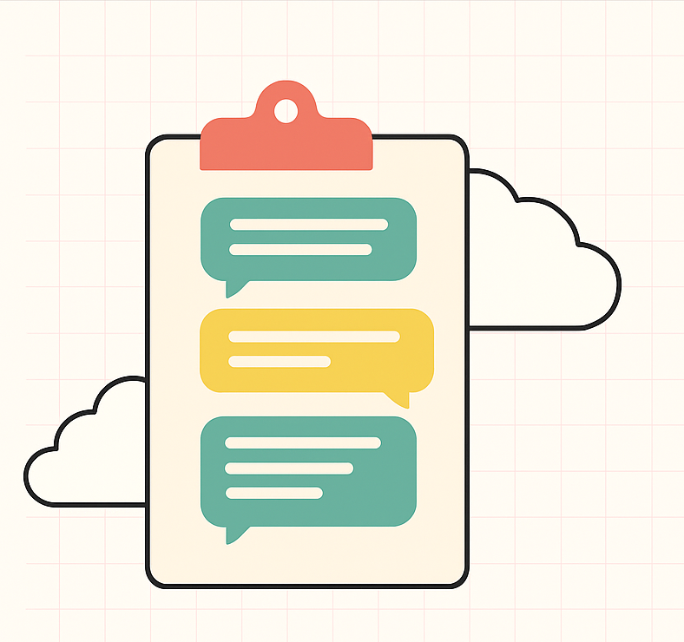
02
Dataset- 1
Model 1
Long-form

Slide 17
Methodology: Model 1(Long-form texts)
 | TinyLlaMA -1.1B | Meta LLaMA-3B
Model Summary | Base: TinyLLaMA/TinyLLaMA-1.1B-Chat-v1.0 Task: Long-form SOP generation Fine-tuning: LoRA via PEFT | Base: meta-llama/Llama-3.2-3B Task: Long-form SOP generation Fine-tuning: LoRA via PEFT
Data | Plain SOPs dataset | Dataset with prompt augmented SOPs
LoRA Configuration | r = 8 alpha = 32 dropout = 0.05 | r = 8 alpha = 16 dropout = 0.1
Training Configuration | Max Length: 512 tokens, Batch Size: 2, Epochs: 5 | Max Length: 2048 tokens Batch Size: 1 (grad acc 4) Epochs: 3
Inference Settings | Temp: 0.6, Top-k: 50, Top-p: 0.95, Repetition Penalty: 1.3 | Temp: 0.4, Top-k: 40, Top-p: 0.8, Repetition Penalty: 1.2
Notes:
Lasya

Slide 18
Methodology: Model 1(Long-form texts) (Cntd..)
Feature | Model A (mistral-manasa-lora) | Model B (mistral-v02-sop-explainer-lora) | Model C (mistral_sop_finetuned)
Model Summary | Base: mistralai/Mistral-7B-Instruct-v0.2 Task: Long-form SOP generation Fine-tuning: PEFT with LoRA | Base: mistralai/Mistral-7B-Instruct-v0.2 Task: Long-form SOP generation Fine-tuning: QLoRA with PEFT | Base: mistralai/Mistral-7B-Instruct-v0.2 Task: Long-form SOP generation Fine-tuning: LoRA via PEFT with LoRA
Dataset Description | Plain SOPs (no reasoning) | Prompt-augmented SOPs + reasoning blocks | Instruction-tuned SOPs
Prompt Format | ### Instruction\n...\n### Response: | <s>[INST] ... [/INST] + [SOP] + [REASONING] | <s>[INST] ... [/INST] followed by [SOP]
LoRA Configuration | (Not specified; loaded pretrained) | r=8, alpha=16, dropout=0.05, bias=none | r=16, alpha=32, dropout=0.05, targeted layers
Training Configuration | Batch size=1, lr=0.0002, losses: Steps=417, train loss=2.56 | Batch size=2, lr=0.00005, losses:Steps=210, train loss=2.59 | Batch size=2, lr=0.0002, losses:Steps=100, train loss=2.26, val loss=2.45
Inference Settings | temperature=0.7, top_p=0.85, repetition_penalty=1.2 | temperature=0.7, top_p=0.85, repetition_penalty=1.2 | temperature=0.7, top_p=0.85, repetition_penalty=1.2
Notes:
Lasya

Slide 19

LLM as judge
Winner - Model B (mistral-v02-sop-explainer-lora)
Notes:
Lasya

Slide 20
Model 1: Quantitative & Qualitative Evaluation of Generation Model Outputs
Feature | Original SOPs | Meta LLaMA (FT + Few-Shot) | TinyLlaMA (FT Only)
Quantitative Evaluation | - | spaCy: 0.9756–0.9907 BERTScore F1: 0.8136–0.8232 Slight edge | spaCy: 0.9818–0.9898 BERTScore F1: 0.8137–0.8226
Structure | Strong narrative flow | Mimics structure well | Loose, more list-like
Tone | Academic, formal, personal | Academic and tailored | General and template-driven
Vocabulary | Rich, domain-specific | Captures technical vocabulary | Simpler, more repetitive
Fluency & Coherence | High | High | Moderate
Style Consistency | Author-specific | Partially consistent with author | Low stylistic retention
Prompt Sensitivity | - | Strong use of prompt signals | Weak adaptation to prompt
Notes:
Lasya

Slide 21
Model 1: Quantitative & Qualitative Evaluation of Model B (mistral-v02-sop-explainer-lora) Outputs
Prompt Label | SOP_Tokens | SOP_Sentences | SOP_Verbs | ROUGE-1 | ROUGE-L | BERTScore-F1 | Observations
In-domain 1 | 578 | 27 | 67 | 0.0468 | 0.0351 | 0.811 | Compact and moderately structured
Out-of-domain 1 | 574 | 28 | 79 | 0.0304 | 0.0304 | 0.815 | Lower lexical similarity, slightly higher BERTScore → generalizes decently
Out-of-domain 2 | 598 | 26 | 79 | 0.0371 | 0.026 | 0.8122 | semantically aligned, not wordy
In-domain 2 | 1026 | 52 | 136 | 0.0402 | 0.0254 | 0.806 | Very long SOP, lots of verbs.
Out-of-domain 3 | 844 | 39 | 147 | 0.0404 | 0.0278 | 0.8001 | Very Rich, coherent
Out-of-domain 4 | 910 | 40 | 119 | 0.0337 | 0.0289 | 0.8029 | Balanced, mildly repetitive; structurally sound and generalizes decently
Notes:
Lasya

Slide 22


Sample Output Comparison: Long-form texts
Author: "I loved watching things work, then ripping them apart to study their mechanism and fixing them back to watch them function the same way."
Model B: "When I was young, I spent hours dismantling electronic gadgets to learn about their inner workings."
Author: "Do it yourself and do it with the best version of your enlightened self. Make no excuses to fall back and seek no apology for learning."
Model B: "Success comes only if you dare to try and fail. Life has shown me both, but what keeps me going is the fear of missing out on opportunities."
Author: "I loved watching things work, then ripping them apart to study their mechanism and fixing them back to watch them function the same way."
Model B: "During my third year, I developed a project called Smart Attendance System which used sensors to detect student presence."
Author: "Learning never stops, and every opportunity to grow is an opportunity to serve better."
Model B: "Learning never stops! So, keep teaching me more."
Early Passion and Curiosity
Resilience and Growth Mindset
Academic & Project-Oriented Achievements
Lifelong Passion for Learning
Notes:
Lasya

Slide 23
03
Dataset-1 & 2
Logistic Model

Slide 24
Summary of Findings (Authorship Classification)
Lexical & syntactic features
Word count & character count filters
Logistic Regression
max_iter = 1000
random_state = 42
For example: Selected only:
≤ 30 words, ≤ 400 characters
> 300 words
Capped each author to ≤ 350 entries
1 Preprocessing
2. Feature Engineering
3 Model Used
4 Dataset Splitting & Balancing
Lowercasing
Stopword removal
Punctuation removal
Word stemming using PorterStemmer
Sample Predictions on Generated Quotes
Quote: "You’ve made it this far, now...The best is yet to come."
Predicted Author: User
Top Probabilities: ✓ User (0.88), Author B (0.10)
Quote: "Ambition pushes us forward. Self-Doubt whispers within."
Predicted Author: Author B
Top Probabilities: ✓ Author B (0.76), User (0.21)
5 Training
6 Evaluation Metrics
Accuracy score
Confusion matrix
Classification report
Text vectorized using TF-IDF
Trained on stemmed quotes

Slide 25
06 Comparison of Results & Observations- Btw Model 1 & 2
Generation
Authorship Classification
Model - 1
Model - 2
Short Form
Short form
Metadata and example-based conditioning - stylistic alignment.
V4- T5 - most controllable and reliable.
.
Model 2 validated - improved with each version of Model 1.
Rejected generic outputs
01
01
Long form
Long form
Consistently validated - user.
Improved stylistic mimicry for mistral-v02-sop-explainer-lora over TinyLlama (in narrative-heavy contexts)
Fine-tuning on prompt-embedded SOPs - coherence, narrative depth, and personalization
02
02

Slide 26
07 Conclusion
Problem we started with: "Creating personalized, high-quality content is difficult—AI-generated text often lacks the unique voice and nuance of individual writers."
Conclusion we reached: Built a grounded and scalable end-to-end pipeline that:
Captured personal voice and nuance using prompt engineering, style vector scoring, and authorship classification.
Resolved hallucination and tone inconsistencies through dataset design and metadata-driven conditioning.
Validated outputs rigorously by combining generation + scoring + verification, ensuring stylistic fidelity.
Message Tie-back: Core challenge - losing individuality in AI writing - Built an ecosystem that generates authentic, emotionally coherent, and verifiable outputs.
Future Work
1
Expand and Diversify Dataset Incorporate more long-form personal writing samples
Multimodal Personalization Voice notes, videos or social media content
Deploy as a Writing Assistant
Integrate pipeline into tools like Notion, Google Docs, or email clients for real-time suggestion and generation.
Interactive Human-in-the-Loop Tool Front-end platform (Provide feedback on AI outputs, Adjust tone sliders).
2
3
4
Notes:
Brinda

Slide 27
08 References
Aborisade, O., & Anwar, M. (2018, July). Classification for authorship of tweets by comparing logistic regression and naive bayes classifiers. In 2018 IEEE International Conference on Information Reuse and Integration (IRI) (pp. 269-276). IEEE.
Hu, E. J., Shen, Y., Wallis, P., Allen-Zhu, Z., Li, Y., Wang, S., ... & Chen, W. (2022). Lora: Low-rank adaptation of large language models. ICLR, 1(2), 3.
Khan, A., Wang, A., Hager, S. and Andrews, N. (2023). Learning to Generate Text in Arbitrary Writing Styles. arXiv preprint arXiv:2312.17242.
Liu, P., Yuan, W., Fu, J., Jiang, Z., Hayashi, H., & Neubig, G. (2023). Pre-train, prompt, and predict: A systematic survey of prompting methods in natural language processing. ACM Computing Surveys, 55(9), 1-35.
Liu, P., Zhang, L., & Gulla, J. A. (2023). Pre-train, prompt, and recommendation: A comprehensive survey of language modeling paradigm adaptations in recommender systems. Transactions of the Association for Computational Linguistics, 11, 1553-1571.
Martinez, F., Weiss, G. M., Palma, M., Xue, H., Borelli, A., & Zhao, Y. (2024). GPT vs. Llama2: Which Comes Closer to Human Writing?. In Proceedings of the 17th International Conference on Educational Data Mining (pp. 107-116).

Slide 28
Nath, S., Li, J. (V.), & Zhang, Y. (2024, August 2). Few-shot prompt engineering and fine-tuning for LLMs in Amazon Bedrock. AWS Machine Learning Blog. https://aws.amazon.com/blogs/machine-learning/few-shot-prompt-engineering-and-fine-tuning-for-llms-in-amazon-bedrock/
Riley, P., Constant, N., Guo, M., Kumar, G., Uthus, D. and Parekh, Z. (2020). TextSETTR: Few-shot text style extraction and tunable targeted restyling. arXiv preprint arXiv:2010.03802.
Sawicki, P., Grzes, M., Góes, L.F., Brown, D., Peeperkorn, M., Khatun, A. and Paraskevopoulou, S. (2023). On the power of special-purpose GPT models to create and evaluate new poetry in old styles.
Wei, J., Bosma, M., Zhao, V. Y., Guu, K., Yu, A. W., Lester, B., ... & Le, Q. V. (2021). Finetuned language models are zero-shot learners. arXiv preprint arXiv:2109.01652.
Zhang, X., Rajabi, N., Duh, K., & Koehn, P. (2023, December). Machine translation with large language models: Prompting, few-shot learning, and fine-tuning with QLoRA. In Proceedings of the Eighth Conference on Machine Translation (pp. 468-481).
Zou, J., Zhou, M., Li, T., Han, S., & Zhang, D. (2024). Promptintern: Saving inference costs by internalizing recurrent prompt during large language model fine-tuning. arXiv preprint arXiv:2407.02211.
OpenAI. (2025). ChatGPT (GPT-4.5, accessed via https://chat.openai.com) [Large language model]. https://openai.com/chatgpt

Slide 29
Thank you!
A B C
Project Github link

Slide 30
07 Conclusion & Future Work
Conclusion
We successfully built an end-to-end pipeline to generate, score, and verify personalized short-form content.
Using prompt engineering, style vector scoring, and authorship classification, we implemented a system that:
Mimics the tone, structure, and emotion of user-authored texts
Ranks rewrites using semantic and stylistic fidelity
Validates AI outputs using a separate classification model
Our approach combined concepts from STYLEMC, TextSETTR, and metadata-driven generation to build a solution that’s both grounded and scalable.
Future Work
Expand Dataset Incorporate more long-form personal writing samples for richer style vectors and broader context modeling.
Fine-Tune LLMs Move from prompt-based control to actual fine-tuning using custom training loops on user data.
Multimodal Personalization Explore style embeddings from voice notes, videos, or social media content to enrich author profile.
Interactive Human-in-the-Loop Tool Build a front-end platform that allows users to:
Provide feedback on AI outputs
Adjust tone sliders (e.g., empathetic ↔ witty)
Deploy as a Writing Assistant Integrate the pipeline into tools like Notion, Google Docs, or email clients for real-time suggestion and generation.
Notes:
Hide

